Slide 1
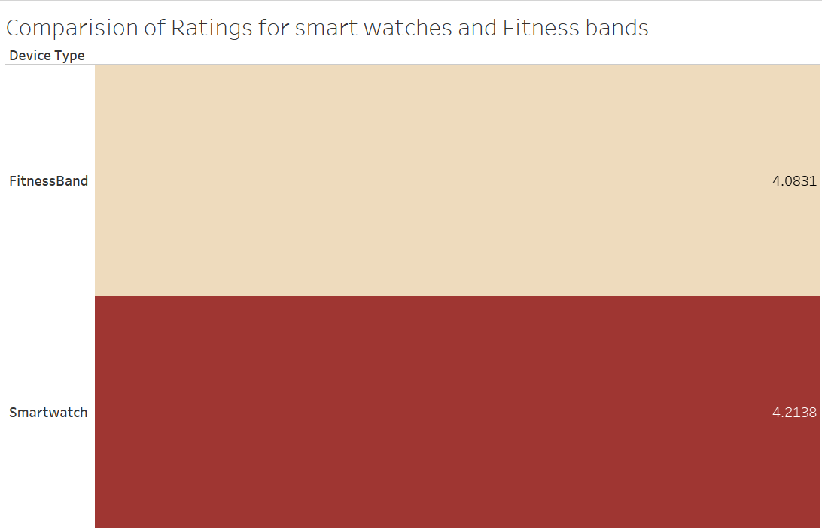

Project on Smart watch and Fitness bands
Damuluri Manikanta

Slide 2
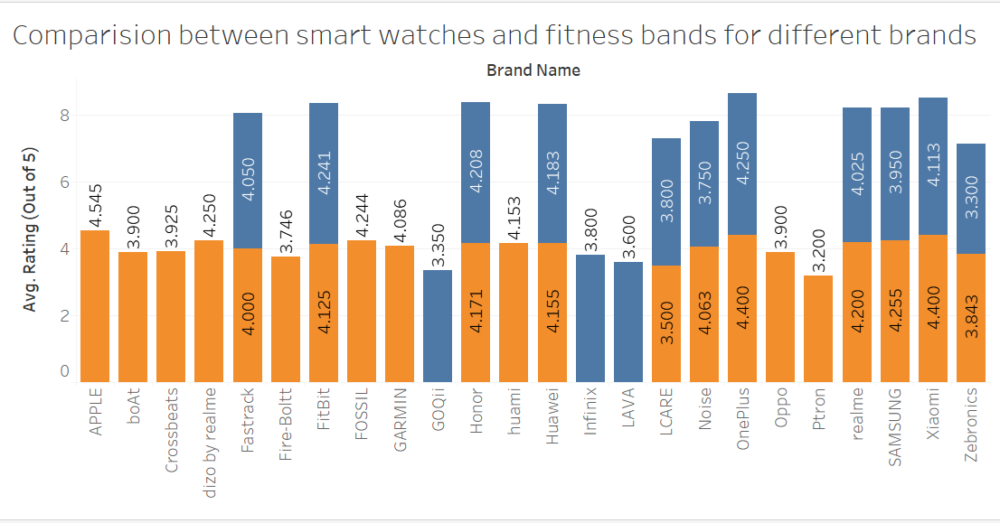


Slide 3
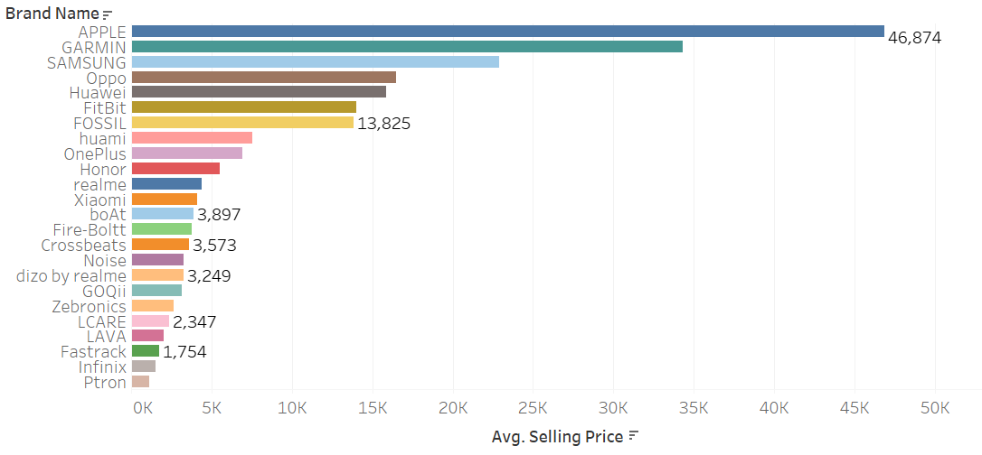
Prices of smart watches comparision between different Brands

Slide 4
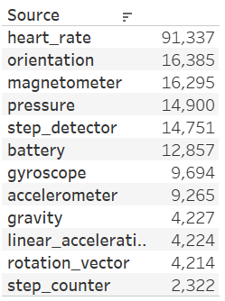
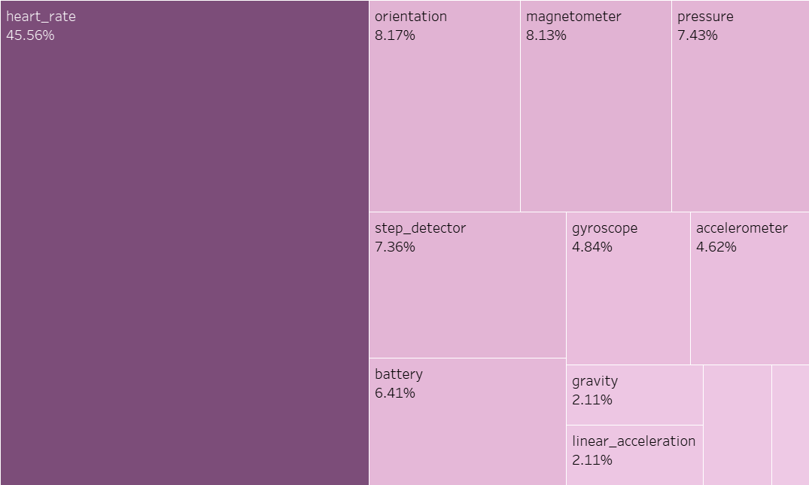
Features in Smart watches and how much users used that Features

Slide 5
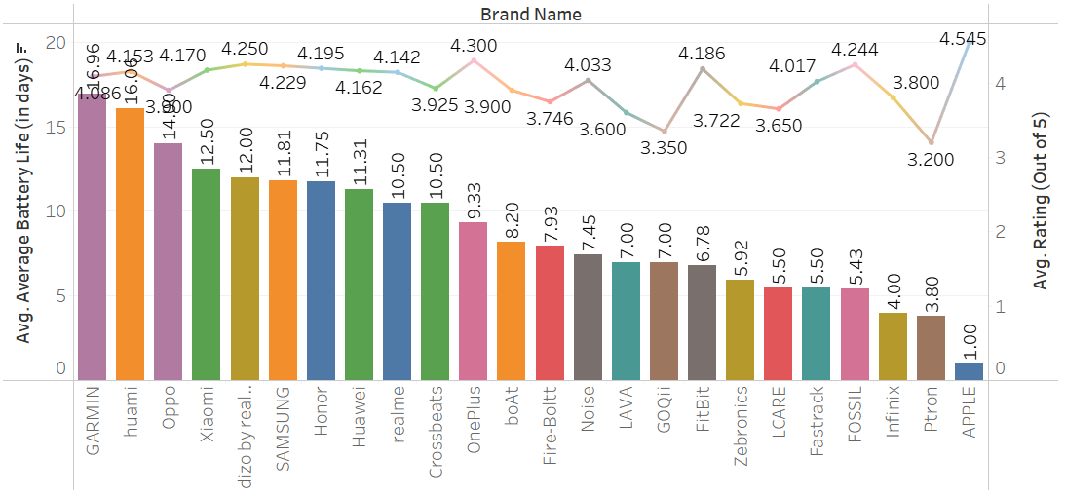
Average Battery Life (in days) for each Brand Name.

Slide 6
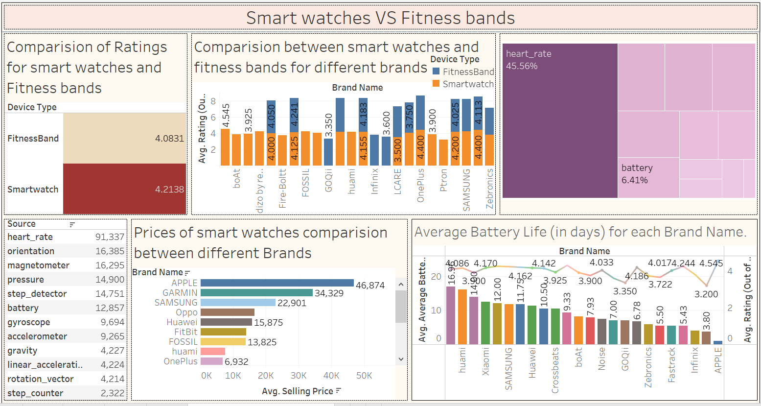

Slide 7
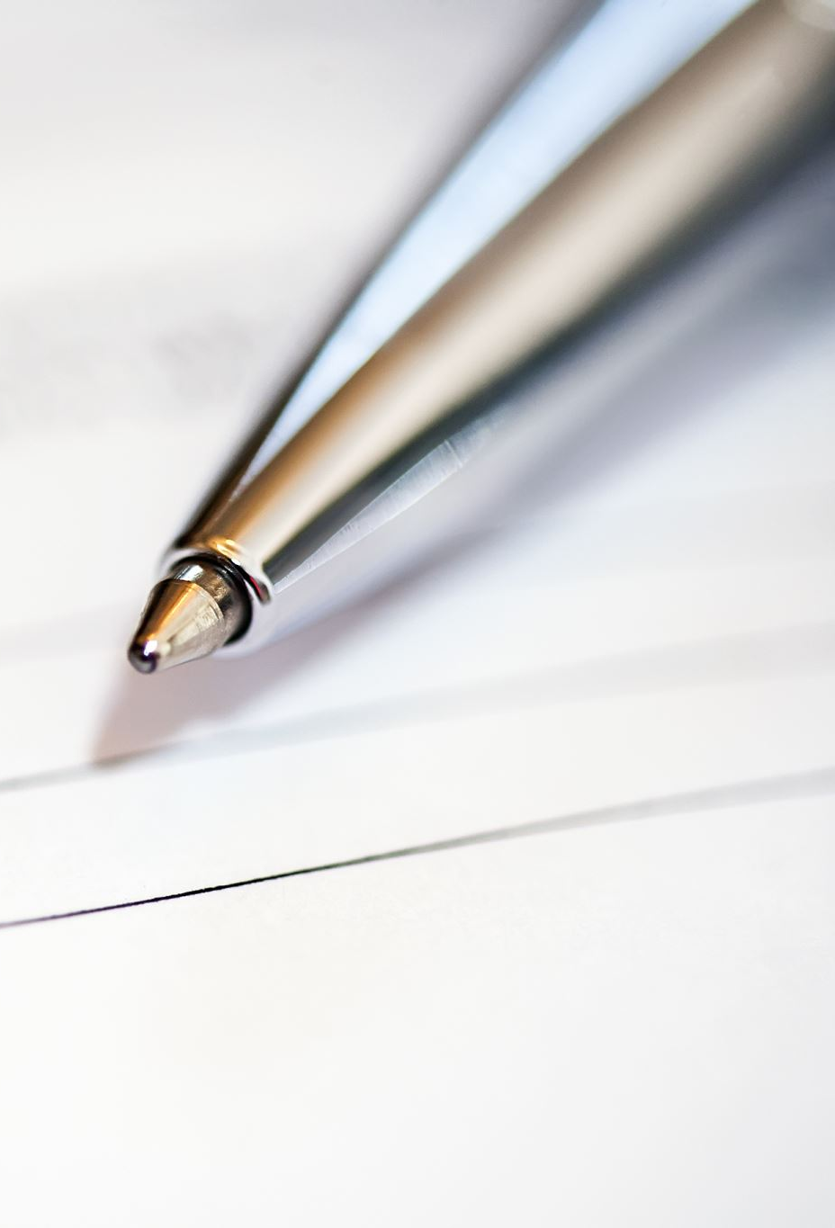
Conclusion
the smartwatch market was growing rapidly, with an increasing number of manufacturers and brands entering the market. The demand for smartwatches was being driven by factors such as rising health consciousness and the growing trend of wearable technology. Some of the major players in the Indian smartwatch market included Apple, Samsung, Garmin, and Fossil. However, market dynamics may have changed since then

